Slide 1
Special event trips
instructions

Slide 2
So you need to book a bus
All special events must be submitted in AppliTrack using the special events conveyance form any time a school wants to go on a trip and requires a nwsd bus. It is up to a staff member requiring bus transportation to book the bus and find their own driver.

Slide 3
SPECIAL EVENTS REQUIRING ADDITIONAL APPROVAL
CONTACT TRANSPORTATION DEPARTMENT TO BOOK SPECIAL EVENT FOR THE FOLLOWING REASONS.
Division Culture Camp
Teacher Convention
E. A/Administrative Workshops
Bus transportation involving multiple schools
BEFORE SUBMITTING A SPECIAL EVENT THAT FALLS UNDER THE EXCELLENCE FUND, A REQUEST MUST BE SUBMITTED TO THE DIRECTOR FROM THE PRINCIPAL. PLEASE CONTACT THE DIRECTORS ASSISANT FOR FURTHER DETAILS.

Slide 4
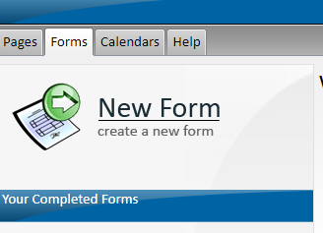
Log into ApplitrACK Select Forms
SELECT NEW FORM
SELECT SPECIAL EVENTS CONVEYANCE FORM – START A NEW FORM

Slide 5
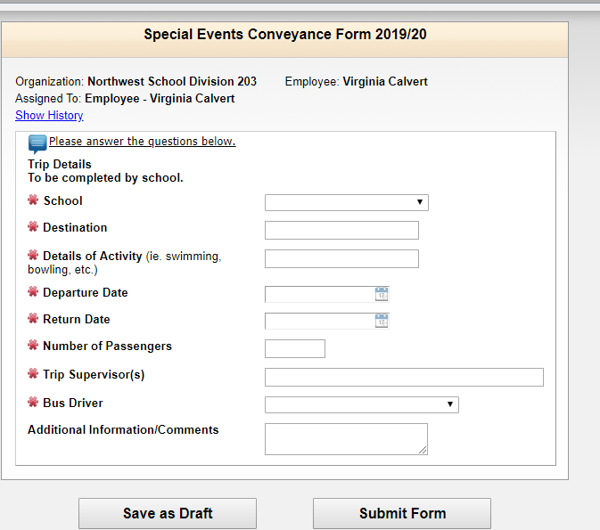
Complete ALL THE SECTIONS ON the form. click submit Form. The Transportation department WILL BE NOTIFIED TO BOOK THE BUS FOR THE EVENT. Details of activity section must idenifity the following types of special events if applicable: -special education (aqua/equine therapy) -ia/home ec &paa -careers fairs /guidance -pre k special events

Slide 6
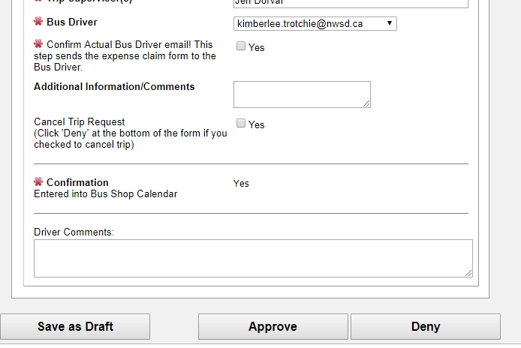
Once your trip has been booked:
The form will go back to the person who originally requested the trip.
ONCE YOUR TRIP IS COMPLETE:
You will now select the driver who actually drove the trip. This may not be the same driver who you originally booked to drive.
The system will send the form to the bus driver to complete expenses after the trip has taken place. Must click yes for “confirm actual driver”

Slide 7
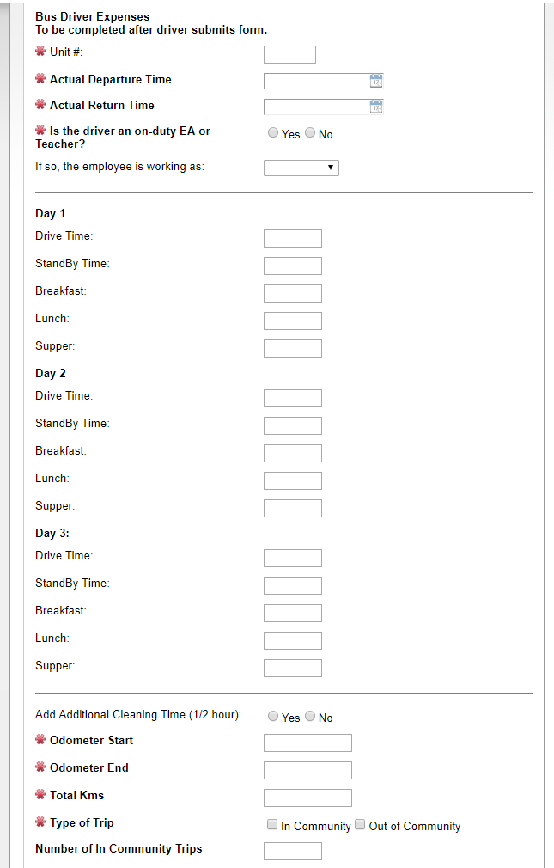
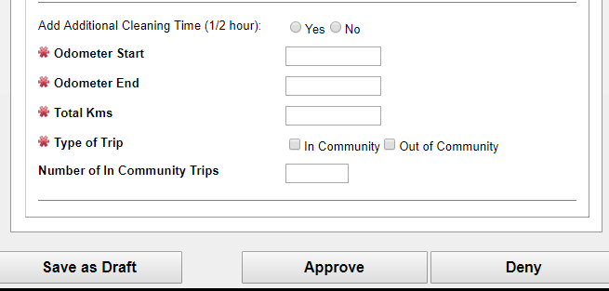
The driver will complete the form, digitally sign and click approve. The form now will go to the principal for approval and digital signature. The form goes back to transportation Department for expense approval and digital signature. Transportation department submits to the payroll department for driver payment.

Slide 8
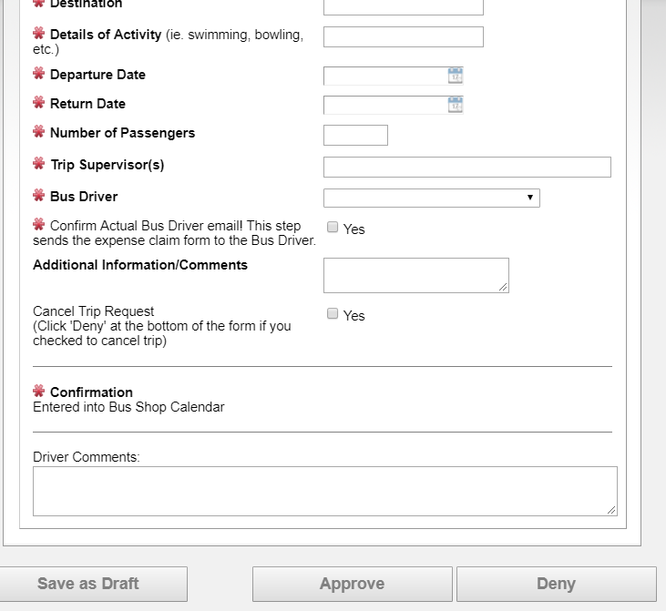
SPECIAL EVENT Cancellation
CANCELLATIONS NEED TO BE COMPLETED BY THE STAFF PERSON THAT ORIGINALY BOOKED THE TRIP.
TRIP MUST BE CANCELLED ON APPLITRACK. LOGIN TO APPLITRACK AND SELECT TRIP YOU WANT TO CANCEL. SELECT CANCEL BUTTON AND DENY AT THE BOTTOM OF THE FORM.
AFTER CANCELLATION IS COMPLETE CONFIRMATION WILL BE SENT TO THE PERSON CANCELLING THE TRIP AND THE TRANSPORTATION DEPARTMENT TO CANCEL THE BUS.

