Slide 1
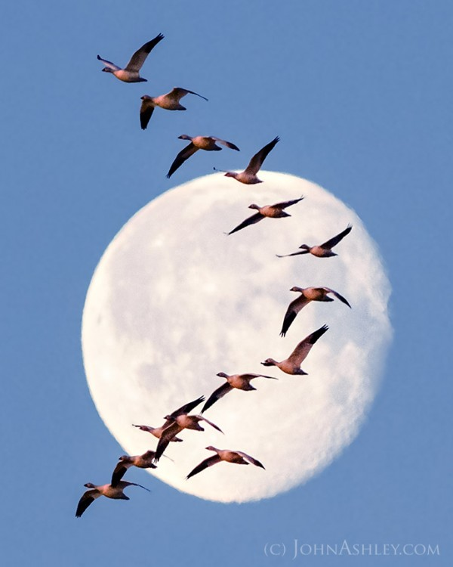
Grade 1
Niskipîsim- March
Land-Based Day
Asâmak (ah sah muk) – snowshoes
Pîmihkân (pee me gun) – pemmican
mistik (miss stick) – log
L’tî (lll tea) - tea

Slide 2
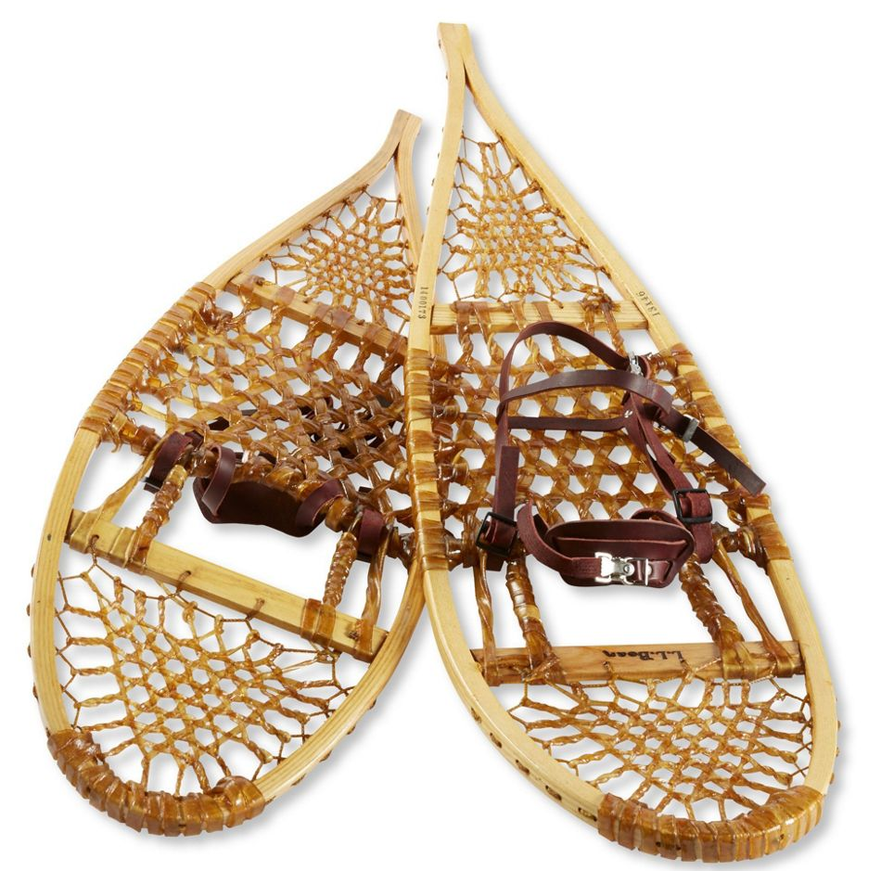
Snowshoes
Long ago, Indigenous people made snowshoes. Snowshoes help feet stay on top of the snow. They are big and wide.
People used wood and hide to make snowshoes. They tied them to their feet. Then, they could walk far in deep snow.
Hunters used snowshoes. Helpers used snowshoes. Kids used snowshoes too!
Snowshoes help people move in winter.
Would you like to try snowshoes?

Slide 3
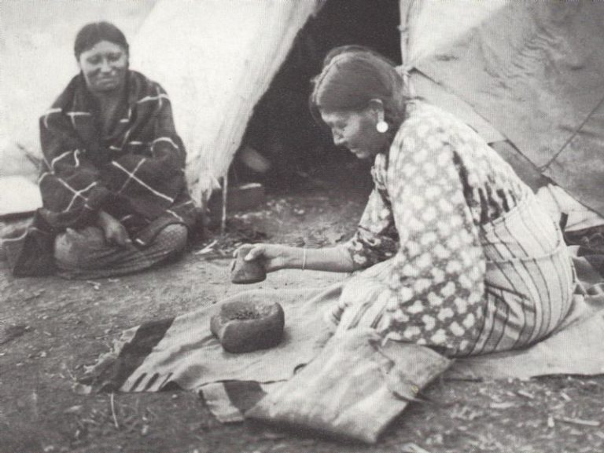
Pemmican
A long time ago, people made a food called pemmican. It was a mix of meat, fat, and berries. The meat was dry. The fat kept it soft. The berries made it sweet.
People took pemmican on trips. It did not go bad. It gave them lots of energy. They could eat it in the cold and in the heat.
Pemmican was good for hunters. It was
good for helpers. It was good for all!
Would you like to try pemmican?

Slide 4
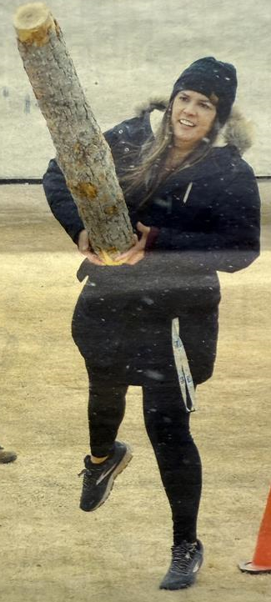
Trapper Games
Trapper games are a great way to keep culture alive. One fun game to play is log toss.
Each person picked up a big log. The log was heavy! They held it tight and tossed it far. People cheered!
The log toss made people strong. It was a fun
game in the snow and in the sun.
Would you like to try the log toss?

Slide 5
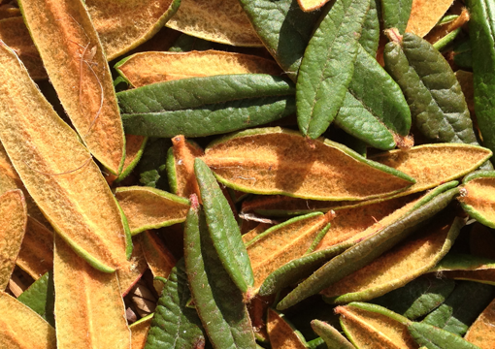
Traditional Tea
Many people make tea from plants. First Nation and Métis people use plants for medicines.
One tea was muskeg tea. It came from small green leaves.
People picked the leaves. They put them in hot water. The tea was warm and good.
Muskeg tea helped people feel well.
It was good in winter. It was good in
summer too!
Would you like to try muskeg tea?

