Slide 1
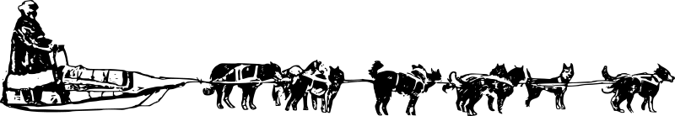
Dog Sled
Atimotapanas

Slide 2
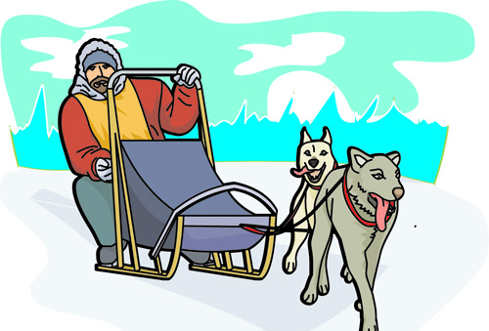
We are going for a ride
E’weposiyak

Slide 3
he/she who pulls the sled
Atimwa kâ otâpahwât

Slide 4
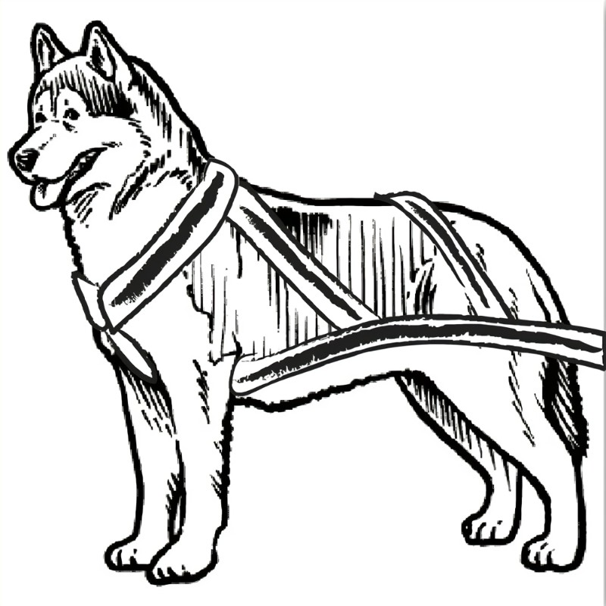
Dog
Atim

Slide 5
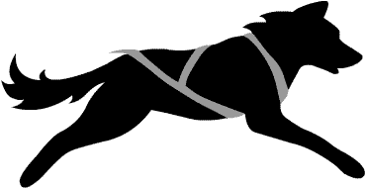
Run
pimpahtâ

Slide 6
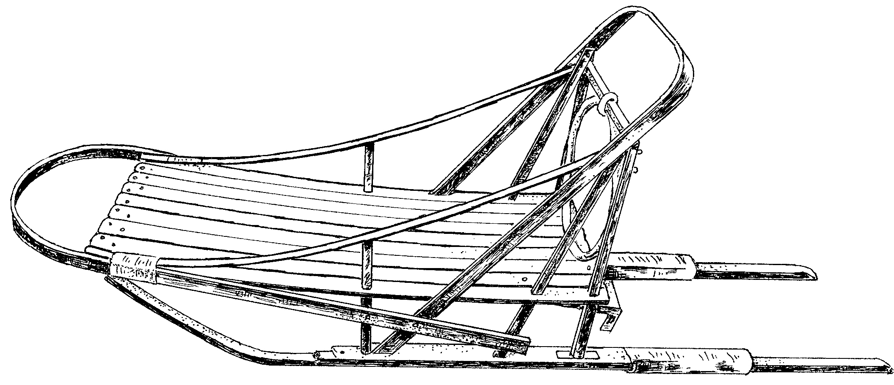
Sled
sôskocêwotâpânâsk

Slide 7

Snow
kôna

Slide 8
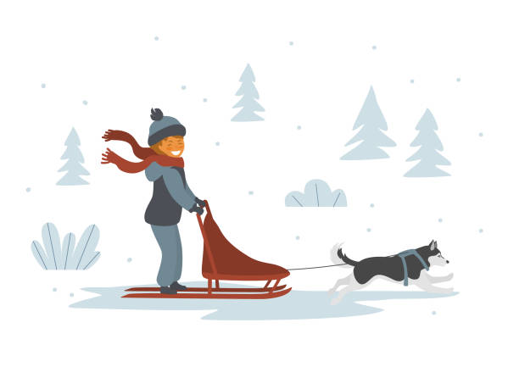
ride
pôse
Pus suh

