Slide 1
Auntie Says
Students will learn the action words in the Michif language.

Slide 2
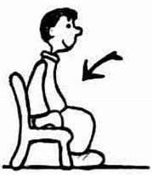
sit
api

Slide 3
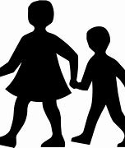
walk
pimohtî

Slide 4

Jump
kwâskohti

Slide 5
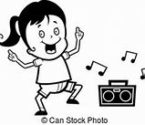
Let’s dance
nîmihitotân

Slide 6
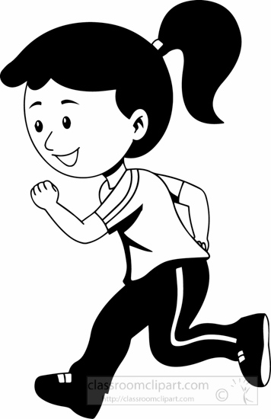
run
pimpahtâ

Slide 7
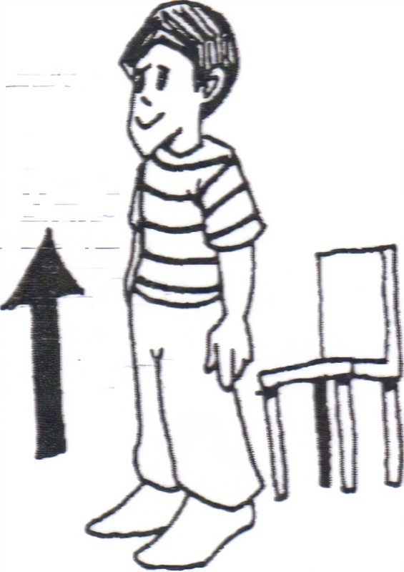
Stand up
nîpawi

Slide 8
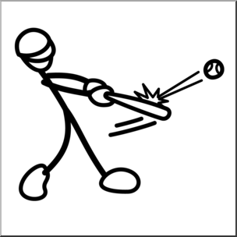
hit/strike
paķamaha

Slide 9
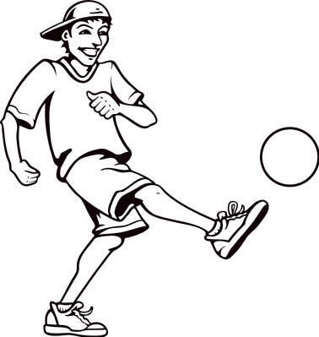
kick
tahkiska

Slide 10
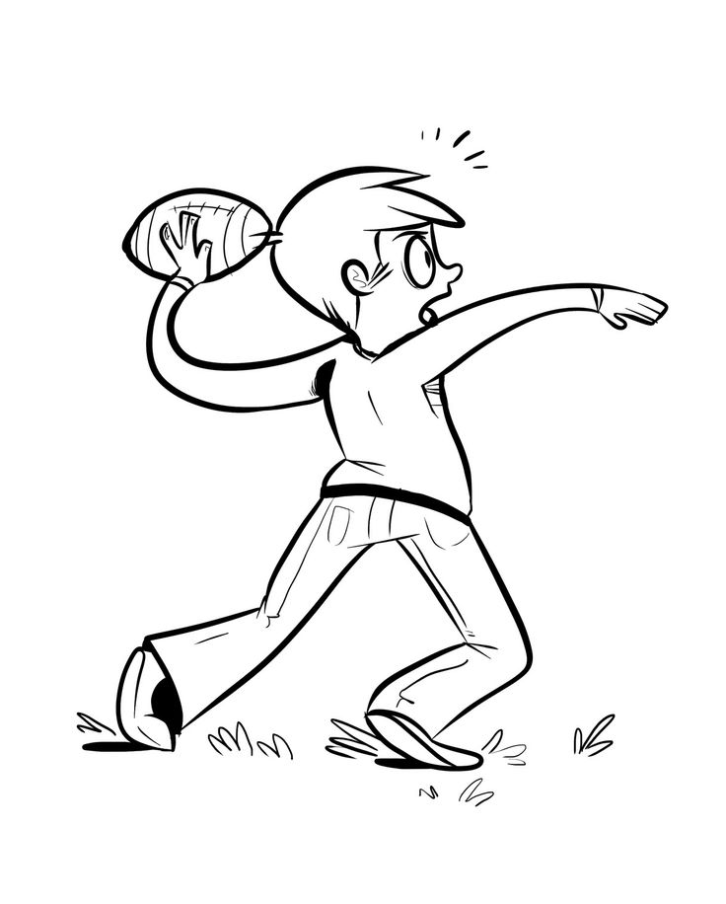
throw it
pimoshinî

Slide 11
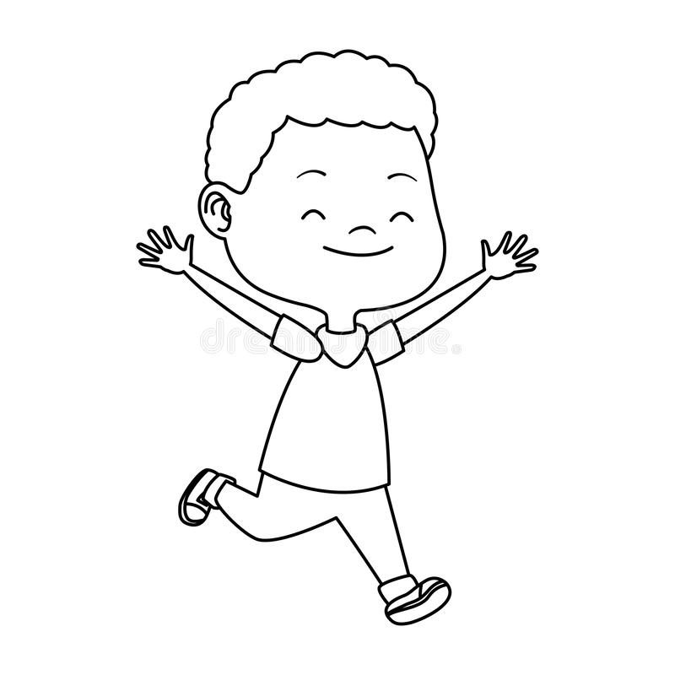
move
waskawî

Slide 12
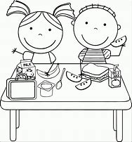
eat
mîciso

Slide 13
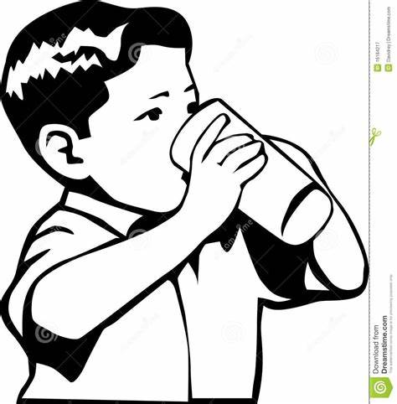
drink
minihkwî

Slide 14
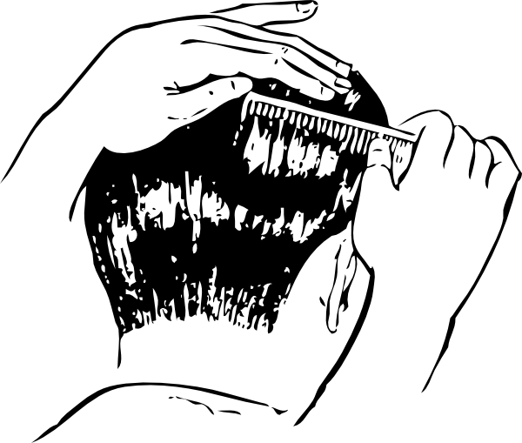
Comb your hair
sîķaho

Slide 15
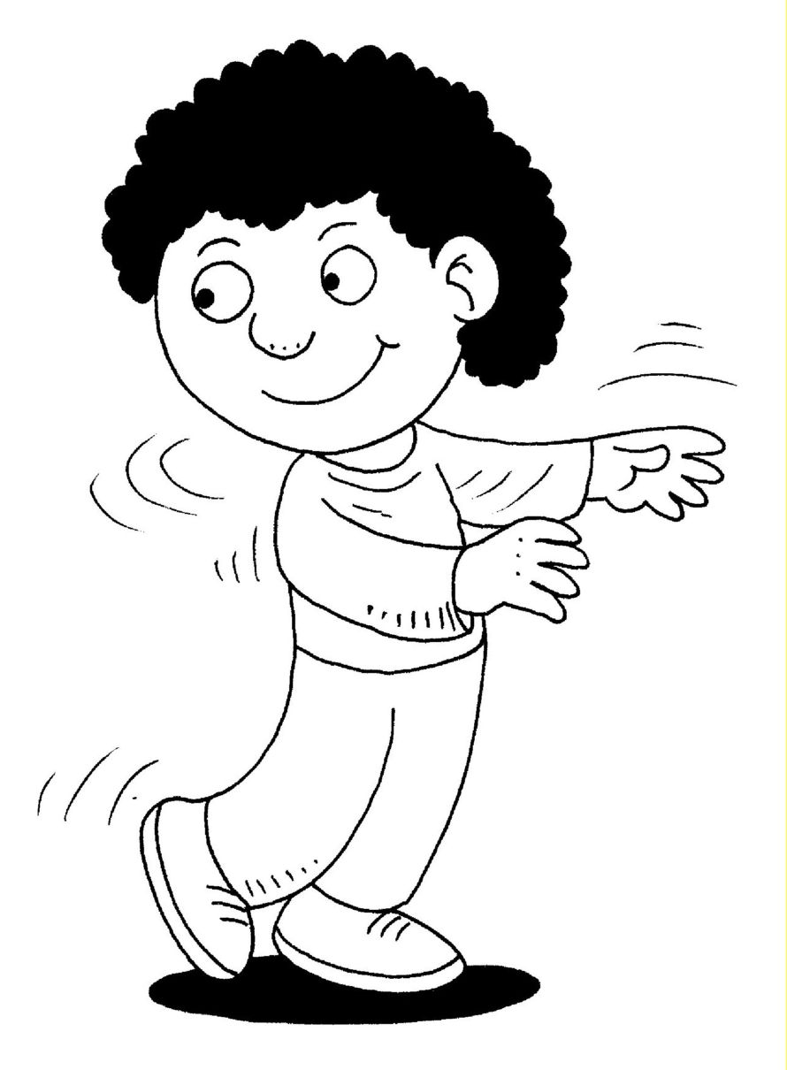
turn
kwîskî
Kwee skee

Slide 16
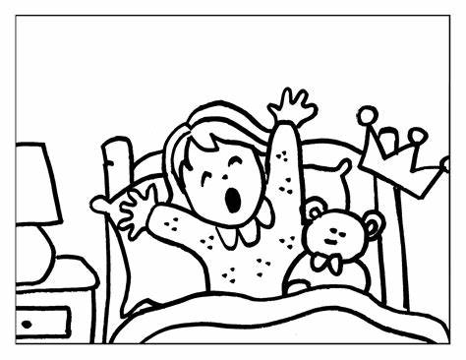
Wake up
waniskâWon is kah

Slide 17

Stop
nakî

Slide 18
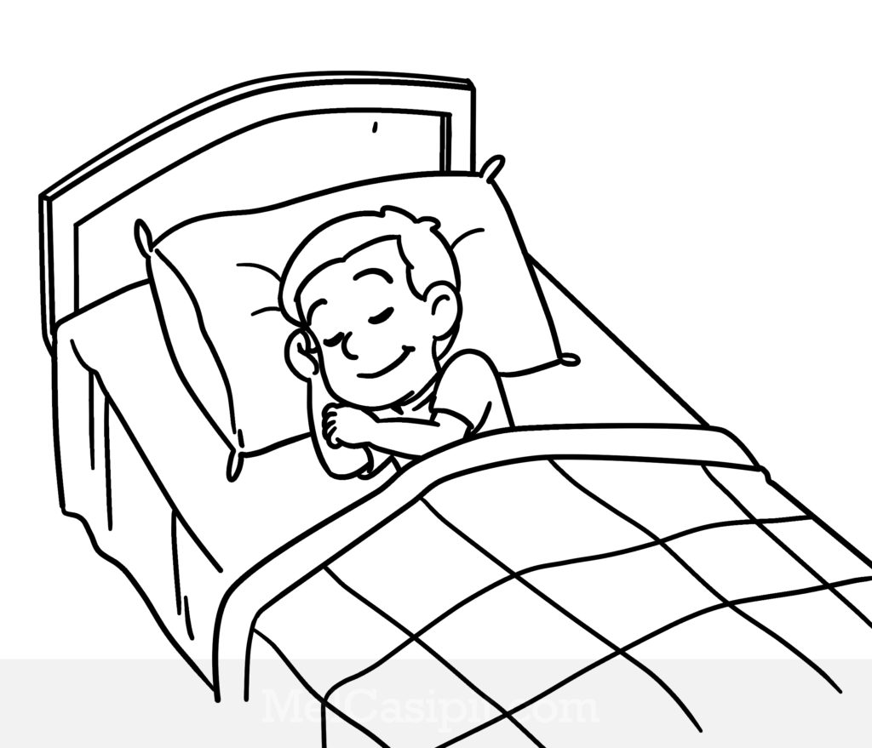
sleep
nipâ

Slide 19
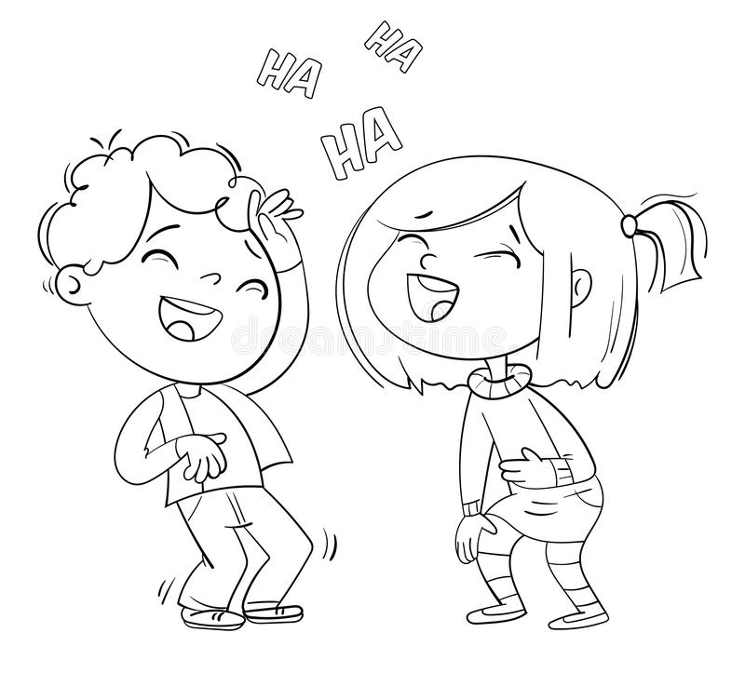
Laugh
pahpi

Slide 20
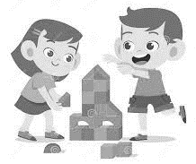
play
mîtawî

Slide 21
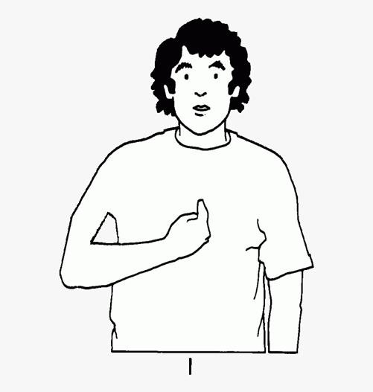
Me or I
niya

Slide 22

you
kiya

