Slide 1

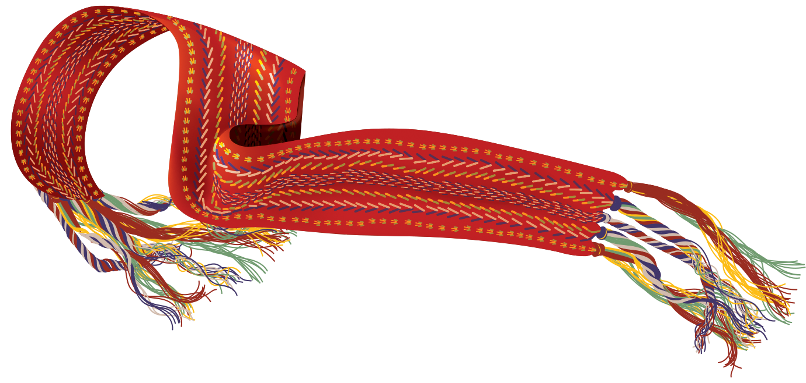
Tawnshi Hello!
Rupertsland Centre for Teaching and Learning (RCTL) is excited that you are exploring our authentic Métis education resources! All RCTL resources have been carefully crafted by our team of Métis educators. We work closely with Métis leaders, knowledge keepers, and community members to produce resources that accurately present authentic Métis voices and stories in education. We, at Rupertsland, are honoured that members of our Métis community have determined us to be a trustworthy voice to share their stories in a meaningful, respectful way.
Educators are invited to use the resources we share to promote Métis voices in their classrooms.
We ask that our resources are not adapted out of their original context.
Do not share beyond an individual classroom without permission.
We take the responsibility of honouring the stories and knowledge that our community shares with us very seriously and so we ensure it is shared in an appropriate manner. We recognize that every teacher and student’s learning situation is unique.
Please write to us with any requests or questions you have about how to best use our resources to fit your specific needs at education@rupertsland.org.
Marsee, thank you!
Rupertsland Centre for Teaching and Learning
Copyright © Rupertsland Institute 2020 and 2021. Display or copying for classroom use is permitted by the rightsholder. To request permission to revise or adapt, please contact the rightsholder.
Notes:
© 2020 Rupertsland Institute

Slide 2
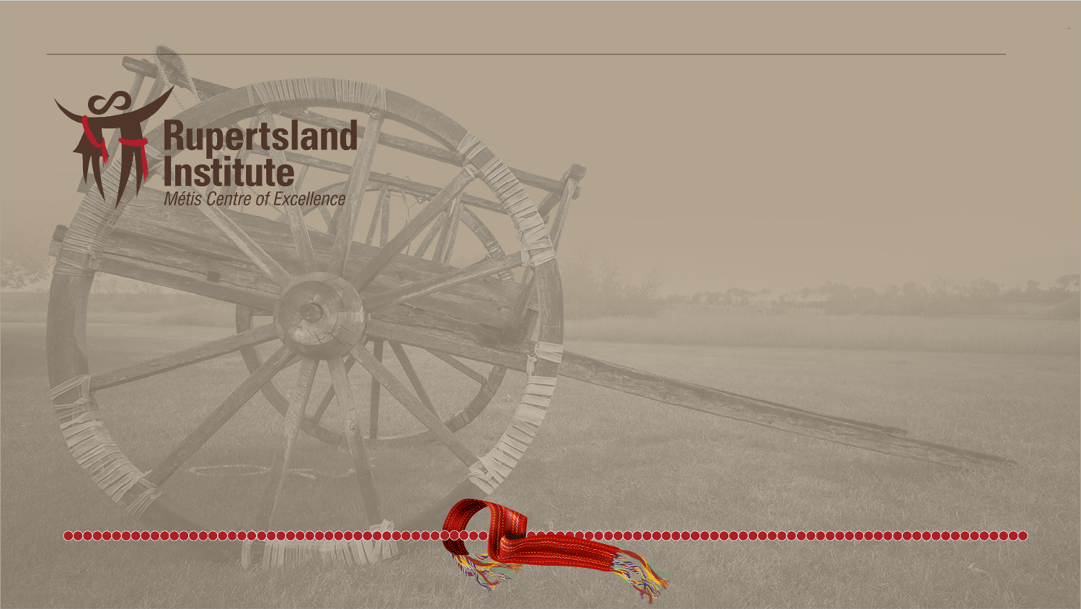
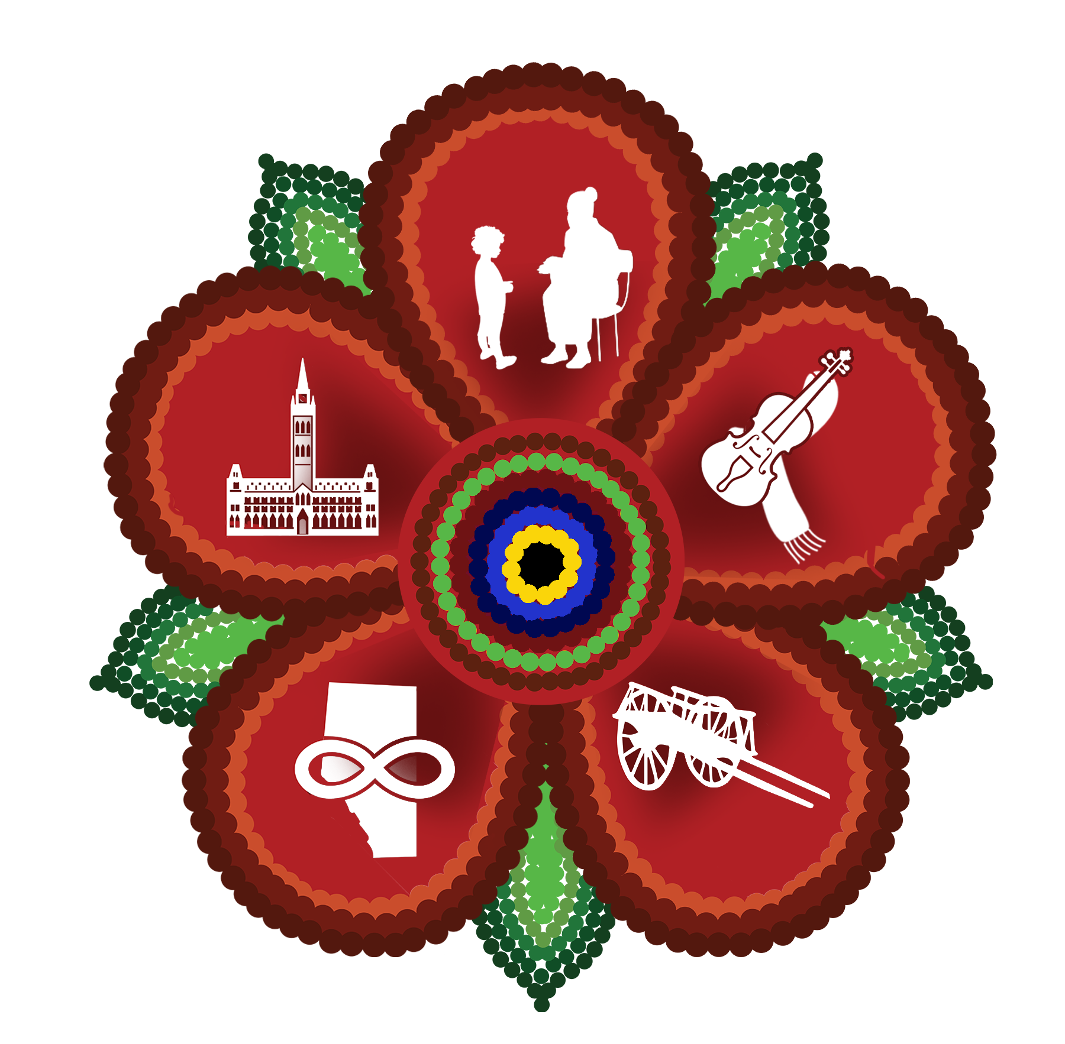
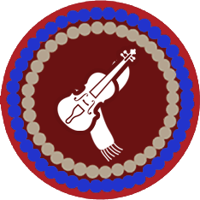
B is for Bannock
Culture & Traditions
Copyright © Rupertsland Institute 2020 and 2021. Display or copying for classroom use is permitted by the rightsholder. To request permission to revise or adapt, please contact the rightsholder.

Slide 3
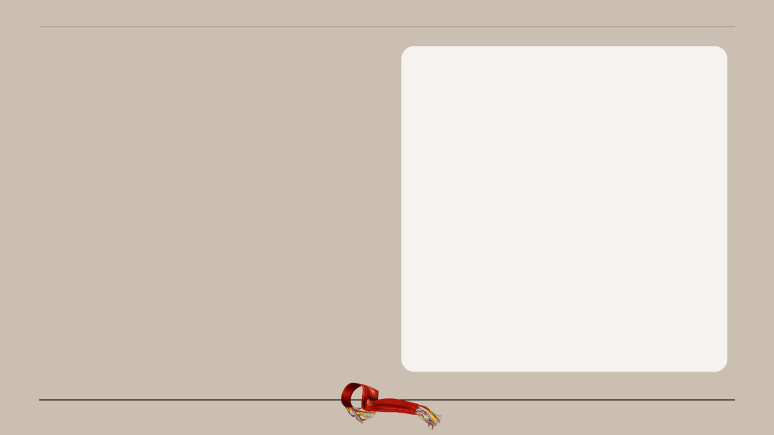
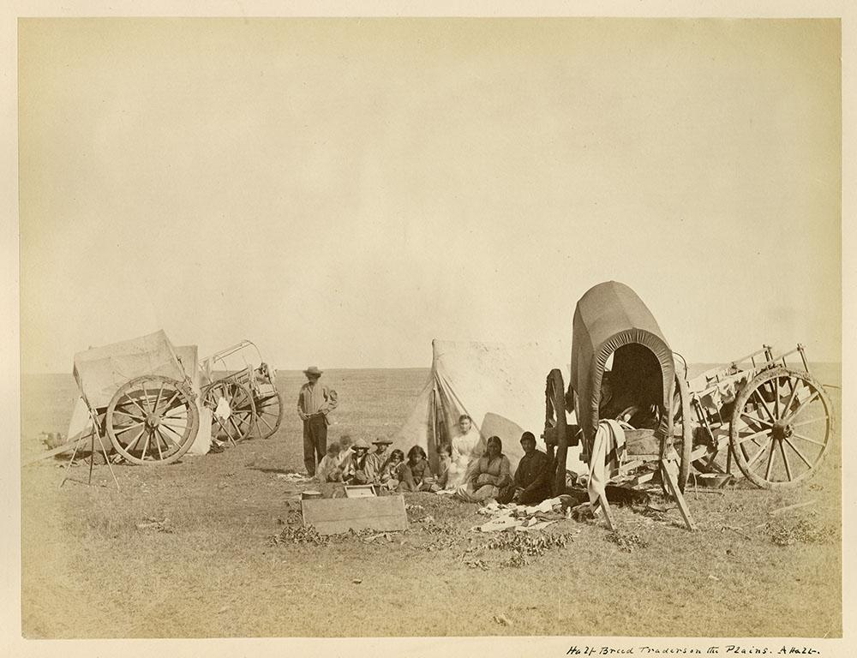
Bannock is made of simple ingredients and is easy to cook.
Bannock
is a
simple flat bread
Why is this important?
Copyright © Rupertsland Institute 2020 and 2021. Display or copying for classroom use is permitted by the rightsholder. To request permission to revise or adapt, please contact the rightsholder.
Notes:
https://commons.wikimedia.org/wiki/File:M%C3%A9tis_Traders_on_the_Plains_-_Marchands_de_fourrures_m%C3%A9tis_sur_les_Plaines_(24392719392).jpg

Slide 4
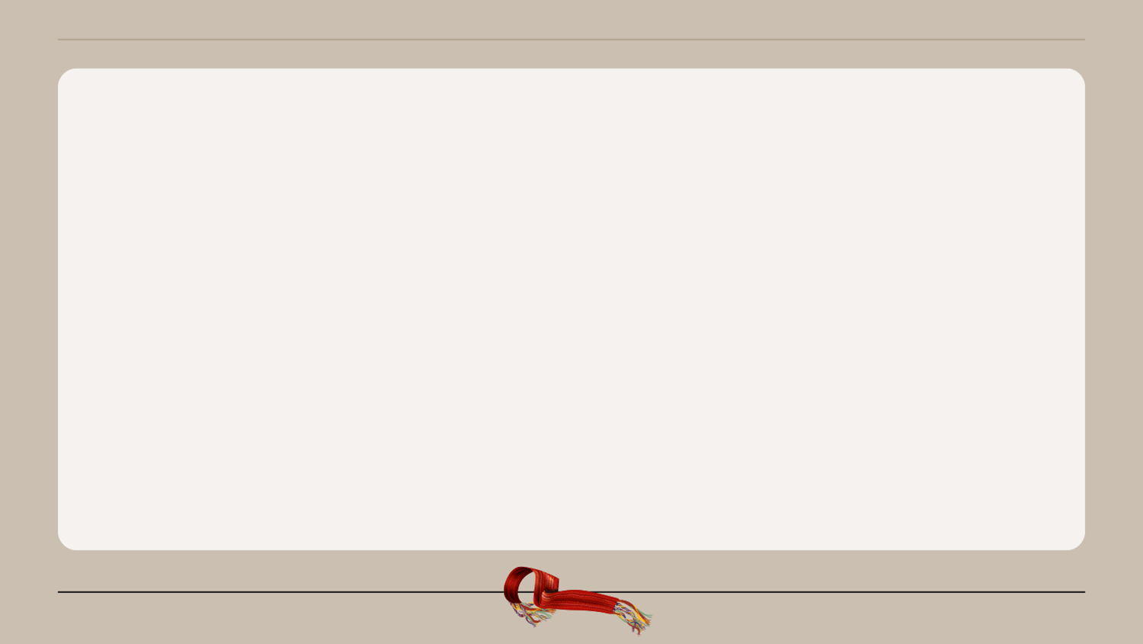
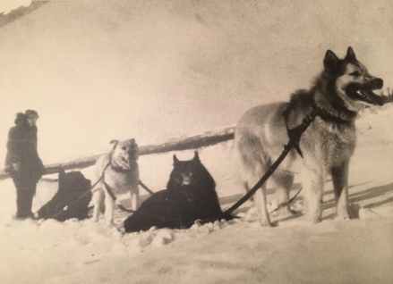
It was easy for a hunter or trapper to throw flour into their sled or wagon and go hunting for days.
Copyright © Rupertsland Institute 2020 and 2021. Display or copying for classroom use is permitted by the rightsholder. To request permission to revise or adapt, please contact the rightsholder.

Slide 5
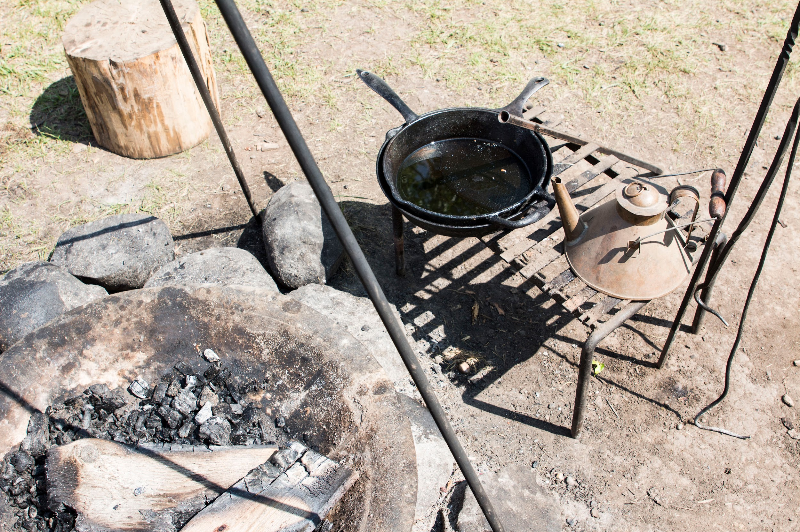
Bannock was first introduced to the Indigenous people by the Scottish Settlers.
Indigenous people then adopted this staple food into their diet as it required few ingredients and was easy to travel with.
Bannock was often cooked on a stick over an open fire, and typically accompanied pemmican and dry meats.
This high-calorie food provided the Indigenous people with the essential energy they needed to live their active lifestyles. Traditionally, bannock was made with only water, flour, and lard.
Copyright © Rupertsland Institute 2020 and 2021. Display or copying for classroom use is permitted by the rightsholder. To request permission to revise or adapt, please contact the rightsholder.
Notes:
http://www.rupertsland.org/wp-content/uploads/2019/06/Culture-Cards-29May2019.pdf

Slide 6
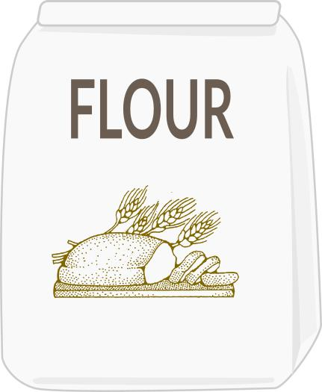
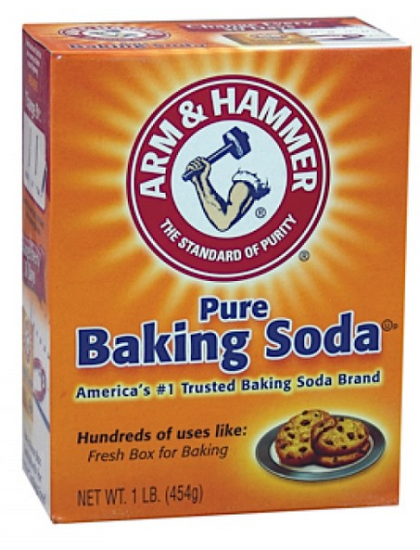

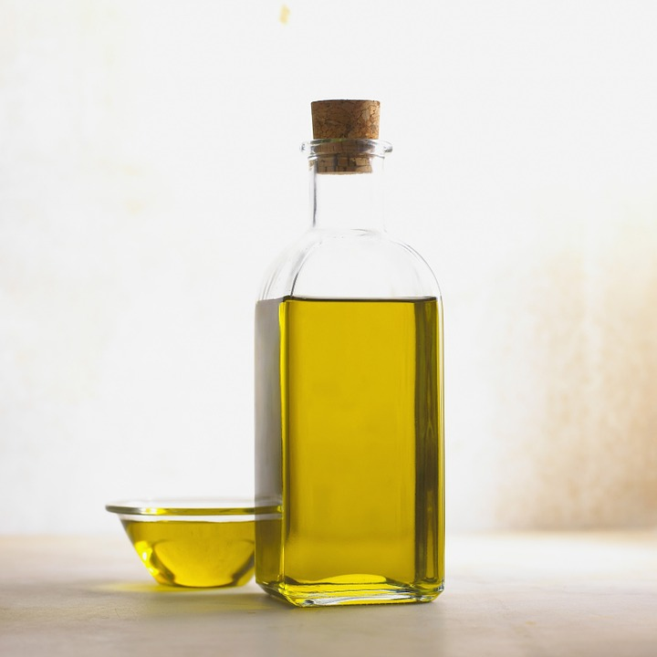
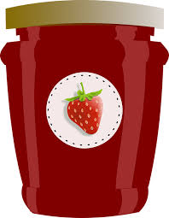
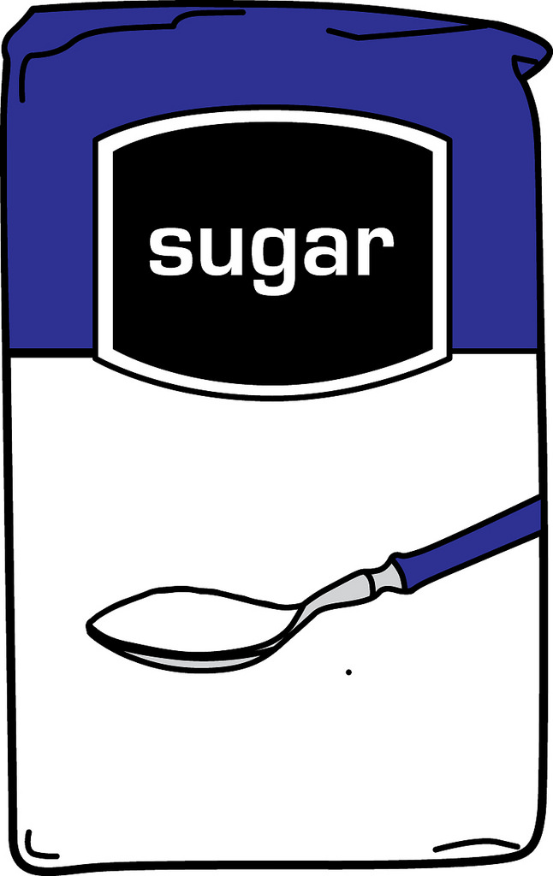
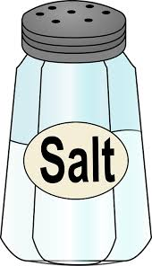
What ingredients do you think we need to make bannock? ✅
Copyright © Rupertsland Institute 2020 and 2021. Display or copying for classroom use is permitted by the rightsholder. To request permission to revise or adapt, please contact the rightsholder.

Slide 7
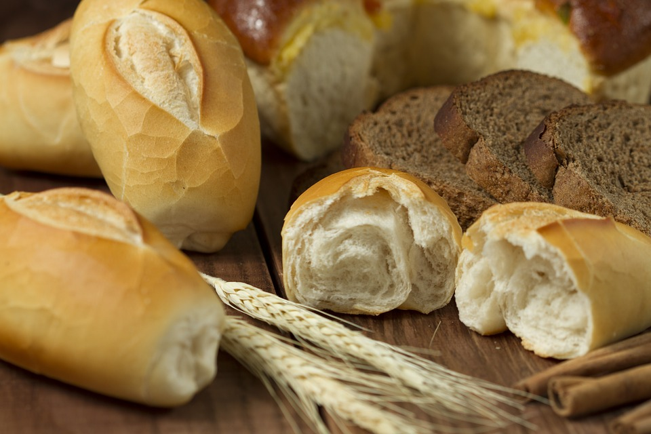
Are there other
foods that you eat
that are similar
bannock?
Copyright © Rupertsland Institute 2020 and 2021. Display or copying for classroom use is permitted by the rightsholder. To request permission to revise or adapt, please contact the rightsholder.
Notes:
naan bread, tortilla, baguette, scone, donuts, bagels, etc
This could be asked pre or post or both!

Slide 8
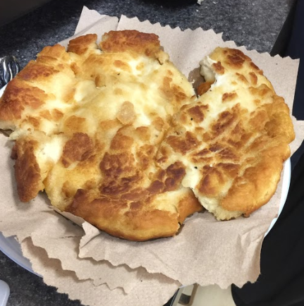
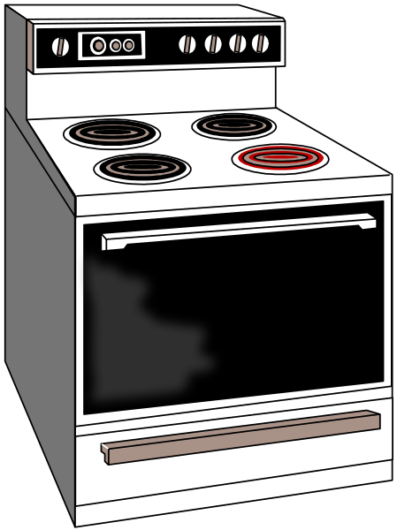
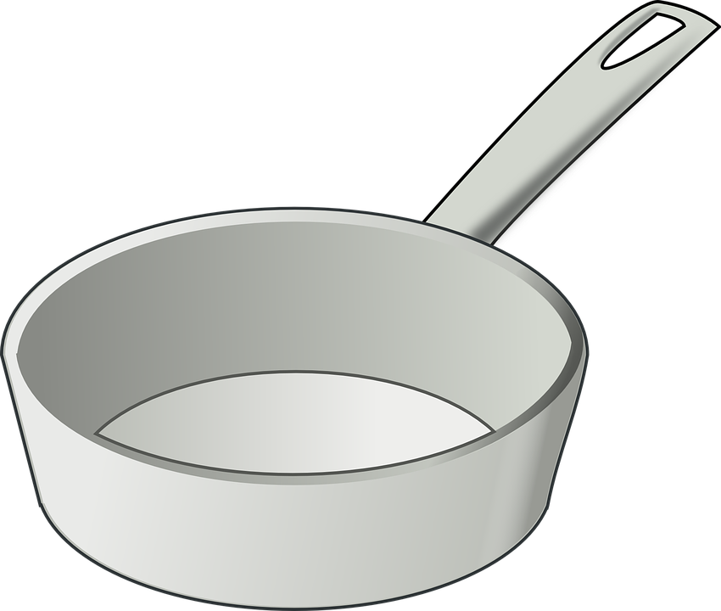
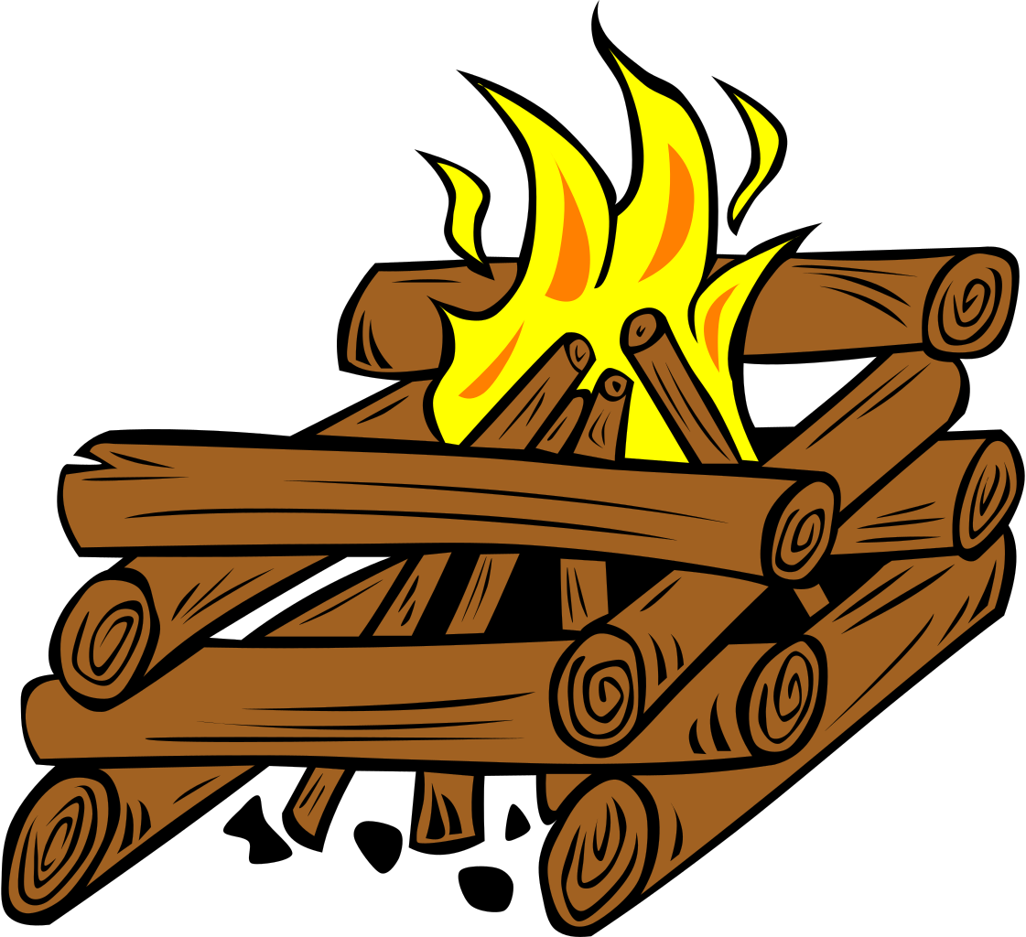
It is easy to mix the bannock mixture and throw it on the fire and have dinner already instead of bread. Bread takes hours to make.
You can make bannock
in the oven, fry it or cook it over a campfire
Copyright © Rupertsland Institute 2020 and 2021. Display or copying for classroom use is permitted by the rightsholder. To request permission to revise or adapt, please contact the rightsholder.

Slide 9
Bannock
INGREDIENTS
3 cups sifted flour
1 teaspoon salt
2 tablespoons baking powder
water
vegetable oil or lard
DIRECTIONS
Mix half the flour with the remaining dry ingredients.
Add water until the mixture becomes thick, "like a paper mache paste".
Add more flour until the dough feels like a soft earlobe.
Heat the oil or lard over a medium-high heat until very hot, but not smoking.
Break off small pieces of the dough and flatten each to the size of your palm, about 1/2-inch thick.
Place the pieces in the hot oil, turn after about 3 minutes, or when golden brown.
Place the bannock on a paper towel to soak up the excess grease.
Serve plain or with your favourite topping
Copyright © Rupertsland Institute 2020 and 2021. Display or copying for classroom use is permitted by the rightsholder. To request permission to revise or adapt, please contact the rightsholder.

Slide 10
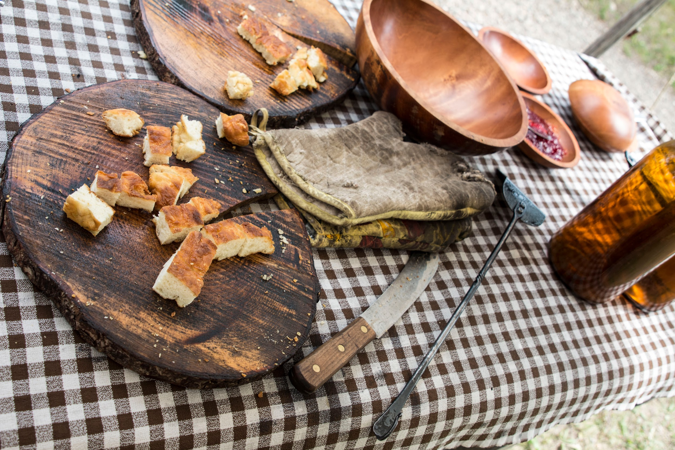
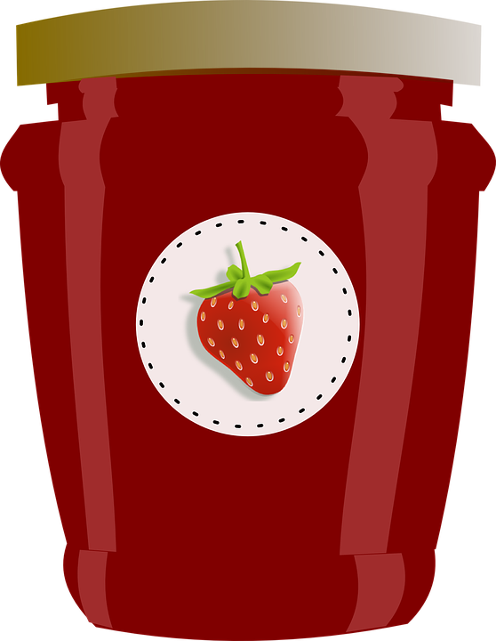
How would you eat
your bannock?
Bannock is a must-have with any deer or moose stew and goes well with some jam.
Copyright © Rupertsland Institute 2020 and 2021. Display or copying for classroom use is permitted by the rightsholder. To request permission to revise or adapt, please contact the rightsholder.

Slide 11
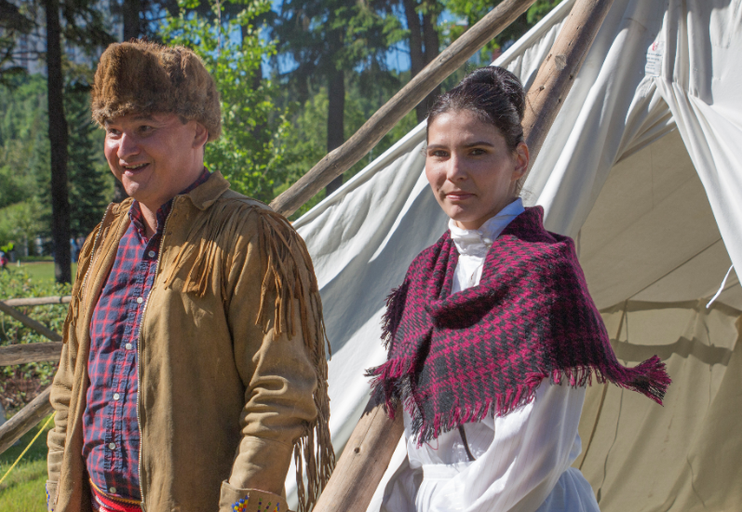
Food preparation is a special part of Métis family life.
It is a place of bonding for mothers, fathers, kohkoms, moshoms, and children.
Sharing what you have is especially important in Métis food culture.
Copyright © Rupertsland Institute 2020 and 2021. Display or copying for classroom use is permitted by the rightsholder. To request permission to revise or adapt, please contact the rightsholder.

Slide 12
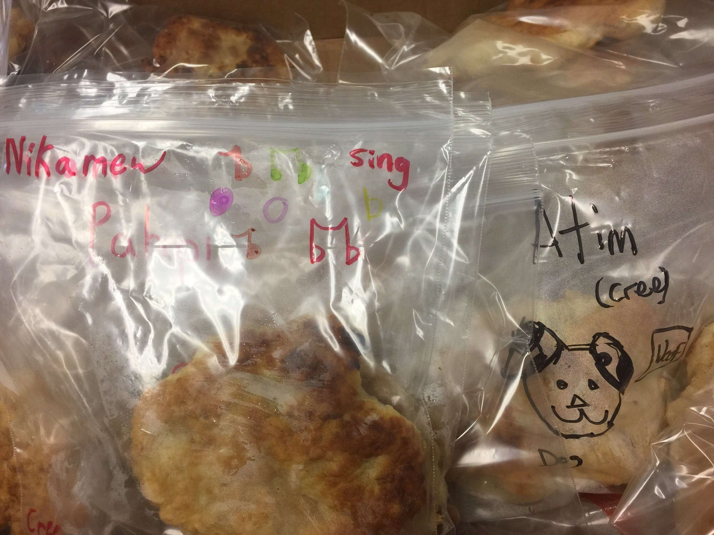
You can write a note in Heritage Michif or Northern Michif to go with your bannock!
English | Heritage Michif | Northern Michif
eat | maanzh | kitâ
friend | aen naamii | mitôtîm
Copyright © Rupertsland Institute 2020 and 2021. Display or copying for classroom use is permitted by the rightsholder. To request permission to revise or adapt, please contact the rightsholder.
Notes:
http://www.metismuseum.ca/michif_dictionary.php
http://www.metismuseum.ca/northern_michif_dictionary.php
*note the French (Heritage Michif) or Cree (Northern Michif) influence

Slide 13
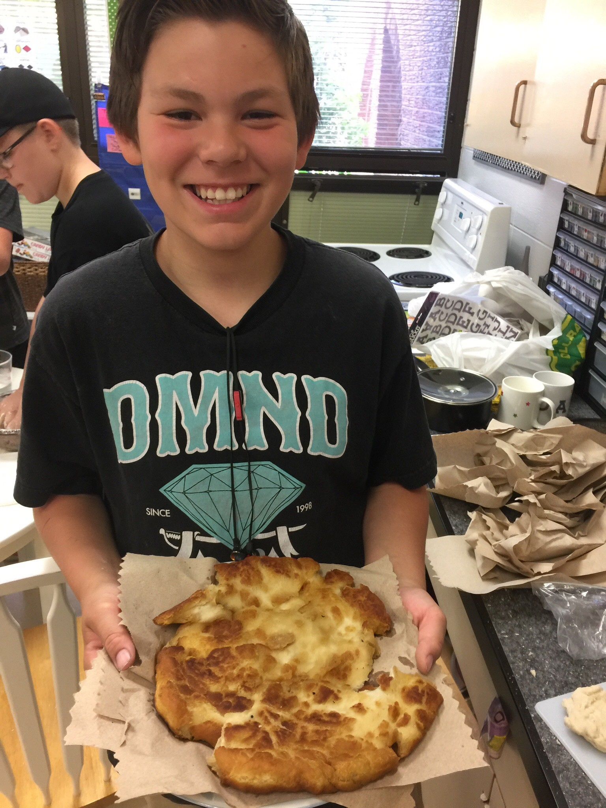
Sharing what you have is very important in Métis culture.
Who will you share your bannock with?
Copyright © Rupertsland Institute 2020 and 2021. Display or copying for classroom use is permitted by the rightsholder. To request permission to revise or adapt, please contact the rightsholder.
Notes:
Cole Laurent

Slide 14
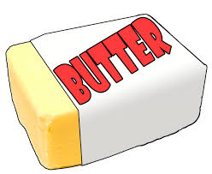
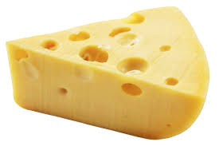
Let’s eat Bannock together!
What is your favourite topping?
Copyright © Rupertsland Institute 2020 and 2021. Display or copying for classroom use is permitted by the rightsholder. To request permission to revise or adapt, please contact the rightsholder.

Slide 15
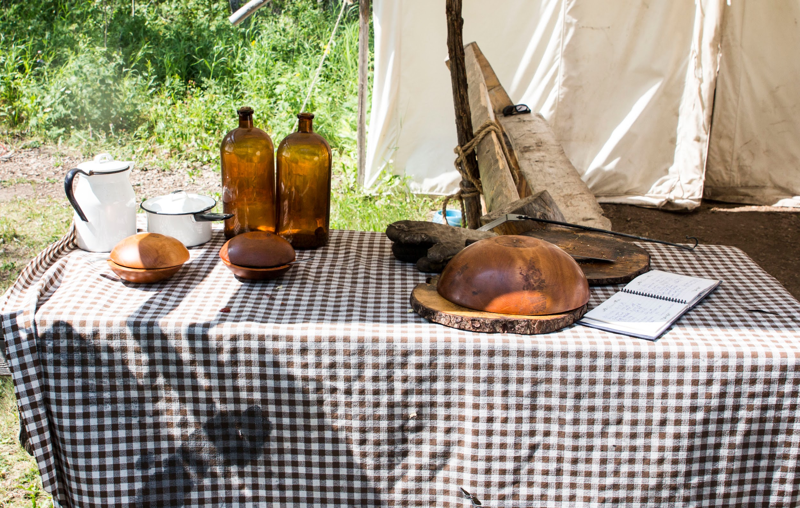
Enjoying food together helps to build community!
Where do you eat food with others?
Who do you like to eat food with?
Copyright © Rupertsland Institute 2020 and 2021. Display or copying for classroom use is permitted by the rightsholder. To request permission to revise or adapt, please contact the rightsholder.

Slide 16
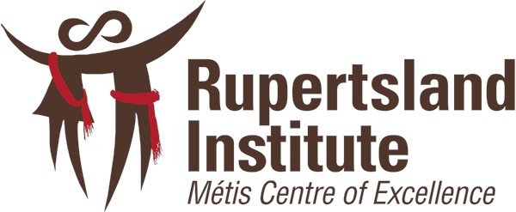
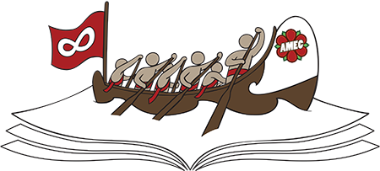
Foundational Knowledge Resource
Rupertsland Institute - Métis Centre of Excellence, Education Team (2020)
Billie-Jo Grant, B.Ed, MRE
2300, 10123 - 99 ST. NW, Edmonton, Alberta, Canada T5J 3H1
T: 780.801.9977 F: 780.801.9992 rupertsland.org
Copyright © Rupertsland Institute 2020 and 2021. Display or copying for classroom use is permitted by the rightsholder. To request permission to revise or adapt, please contact the rightsholder.

