Slide 1
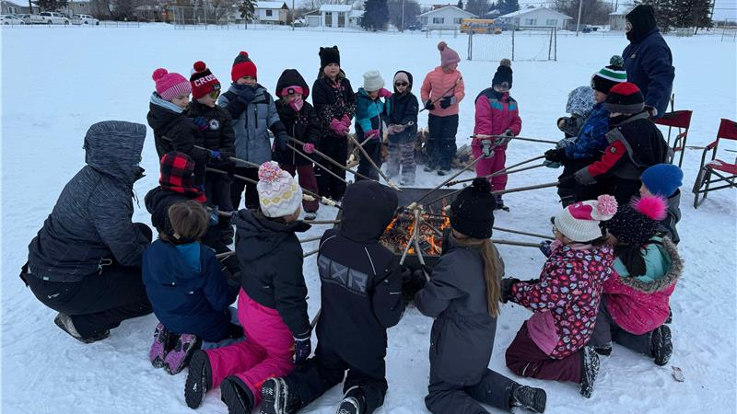
Laķalet - Bannock on a stick

Slide 2


Slide 3
Pre-Learning
Brainstorm the ingredients in bannock.
Create an experience line or groups from most experience making bannock to no experience or Make Bannock and Eat it – Ate it but not made it – Never made or ate it.
Learn the Michif or Cree words for bannock and/or ingredients.

Slide 4
Post-Learning
Students can draw a picture and write sentences about it.
Procedure writing on how to make bannock.

Slide 5

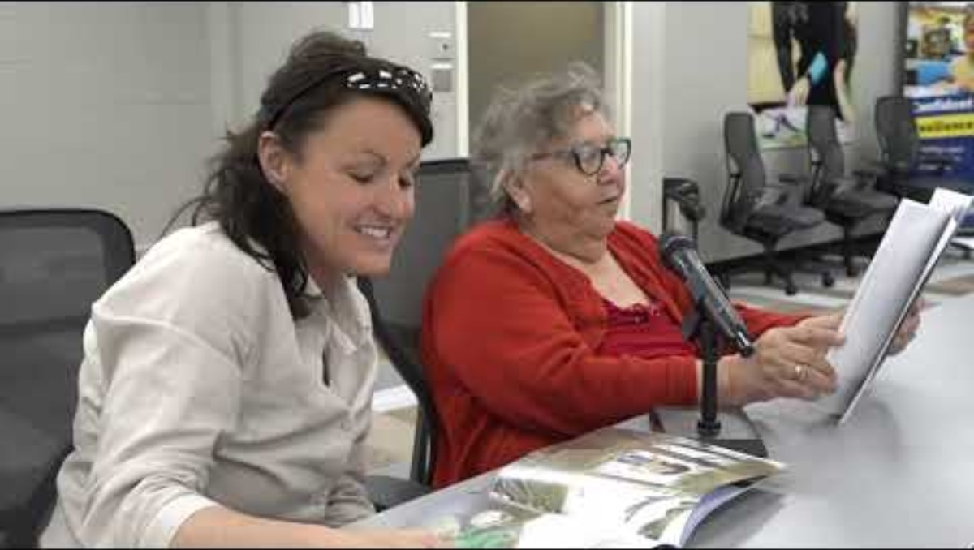
Awâsis and The World Famous Bannock

Slide 6



Slide 7



Slide 8



Slide 9
